Slide 1

Analysis of Unicorn Companies
Quantum Analytics // June Cohort
Michael Biney

Slide 2
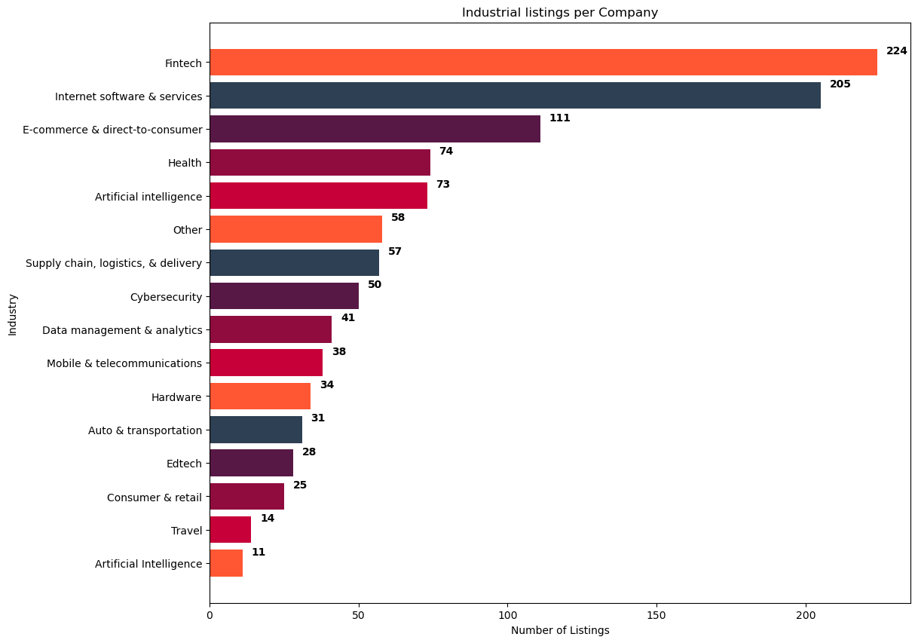
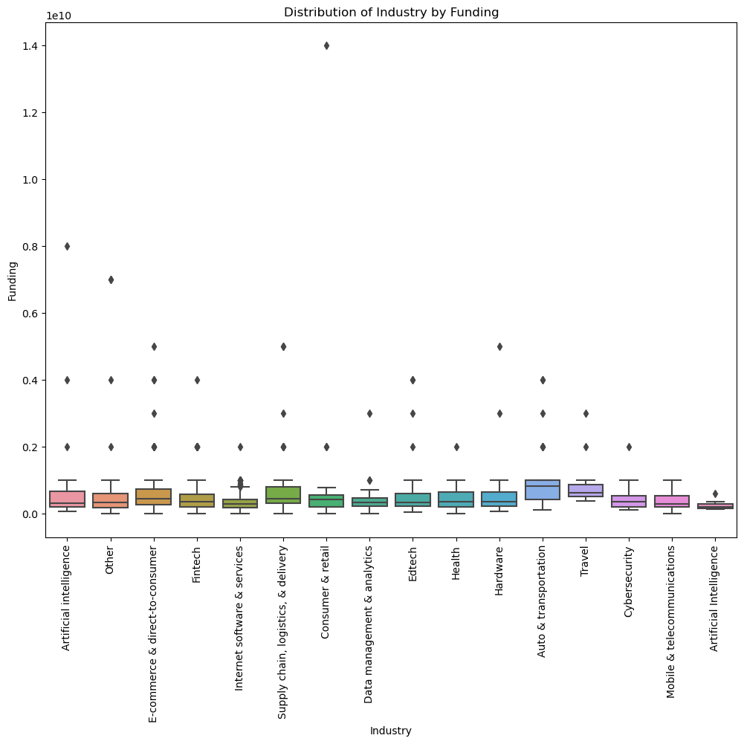
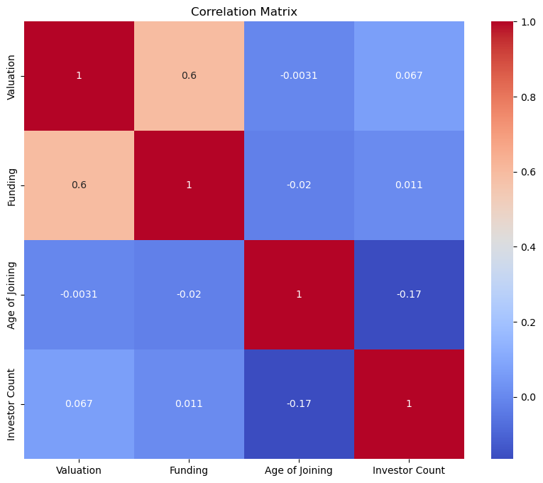
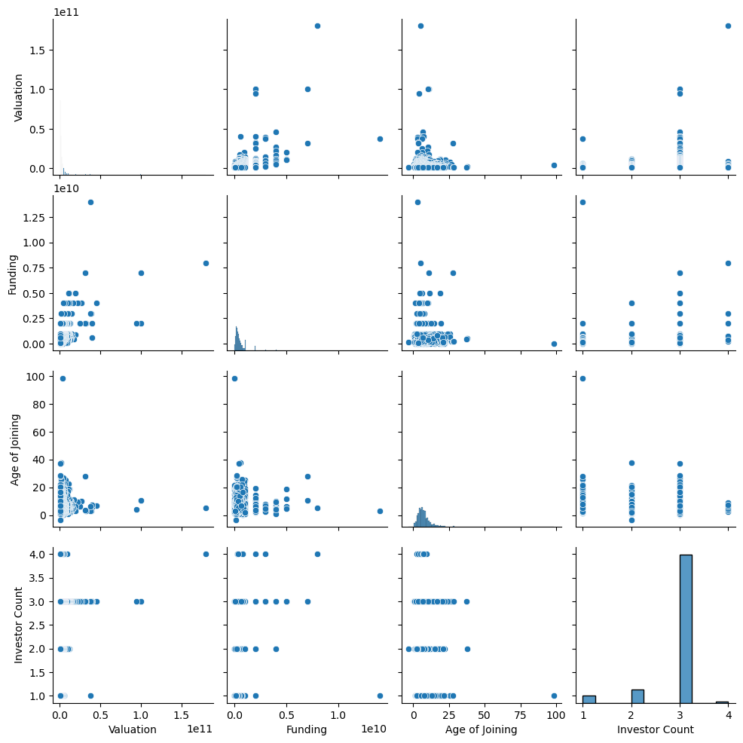

Univariate Analysis
Bivariate Analysis
Multivariate Analysis
Analysis of Industrial Listings per country
Analysis of distribution of Valuation by Country
Analysis of Correlation Matrix using Num_Values
Fintech records the highest listings with a value of 224, whiles Artificial Intelligence recorded the lowest listings with a value of 11. It is not surprising to see FinTech record this value because of the widely use and need for Financial Technology companies especially in a period where money is effective in all sectors. Artificial Intelligence is a slow growing Industry and is gradually making waves. therefore if more knowledge about it is spread properly its technology can be infused in FinTech for safety and security in business Technology.
Auto & transportation has the highest funding median value of 0.1Billion whiles Artificial Intelligence records the lowest median value
The above correlation matrix heatmap provides a visual representation of the relationships between multiple variables in the dataset. The color of each cell indicates the strength and direction of the correlation. The Darker colors (red & 1)indicate a stronger correlation, while lighter colors( light blue, 0.067, investor count and Valuation) indicate a weaker or no correlation. The numbers within each cell represent the correlation coefficient value.

Slide 3
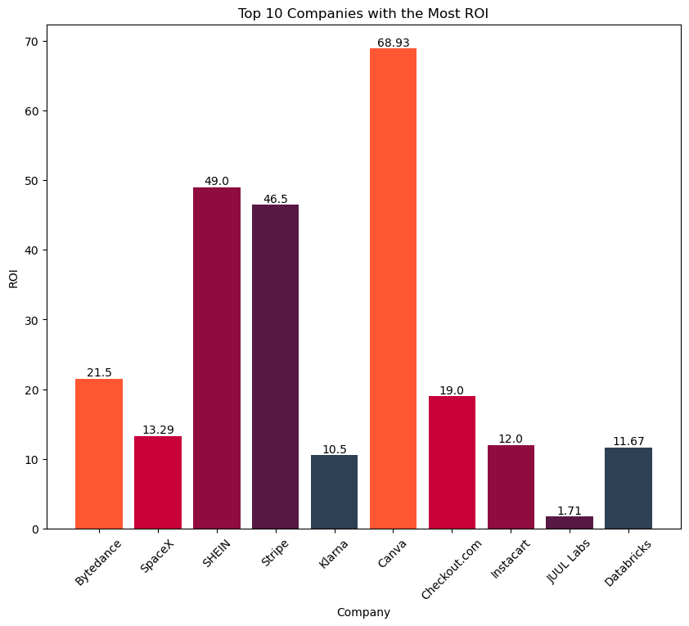
Which unicorn companies have had the biggest return on investment?
Observation
from the bar chat above, Canva recorded the highest ROI with a value of 68.93, whiles JUUL Labs records the lowest ROI of 1.71. This clearly shows the wide customer base for Canva as a designing application and otherwise for JUUL Labs. I suggest JUUL Labs can begin to look into developing more humanitarian based solutions and then support from the Government as investment whiles encouraging other investors by providing them safe space to invest.

Slide 4
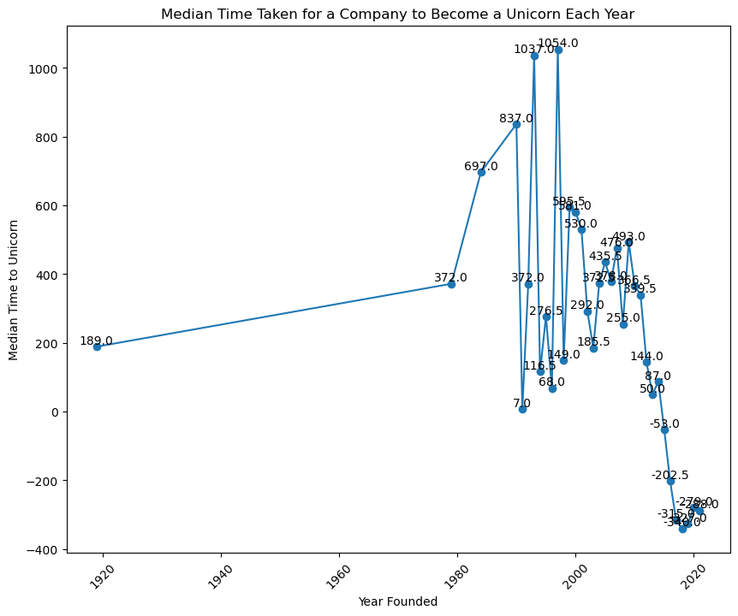
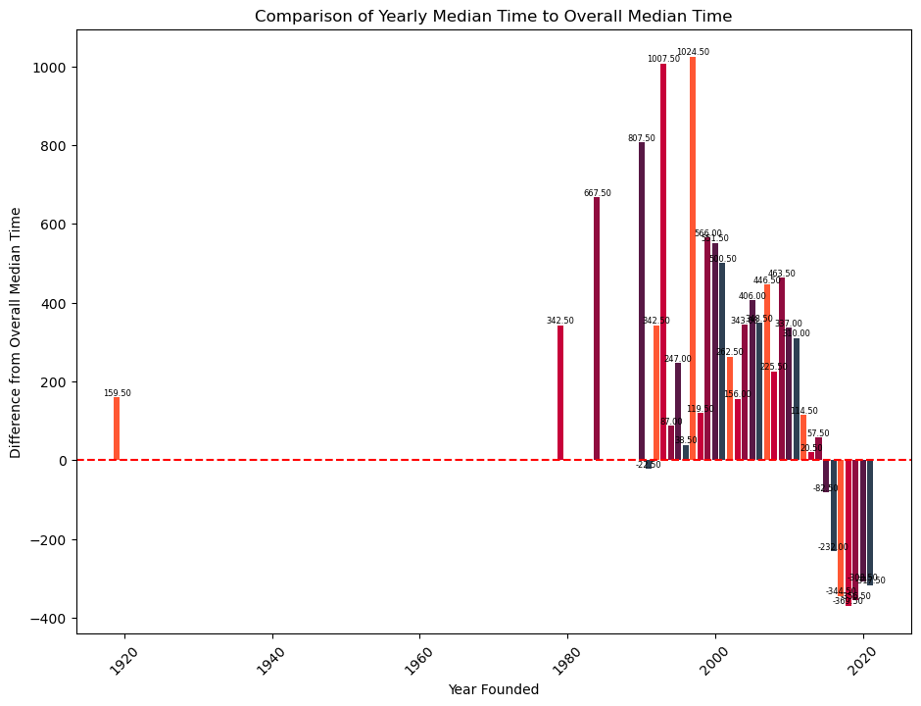
How long does it usually take for a company to become a unicorn? Has it always been this way?
Observation
The x-axis reveals the year in which these remarkable companies were founded, while the y-axis showcases the median time taken for them to achieve unicorn status. The markers and label point out the exact median year for a company to be a unicorn, and shows how far each company has come through hard work and dedication to reach this far. on the other hand, it takes 29.50 median time for a company to be a unicorn. Overall, this visualization effectively communicates the median time taken for a company to become a unicorn each year. The combination of the line plot, data points, and data labels provides a comprehensive and visually appealing representation of the trends and patterns in the unicorn landscape over time.
Observation
The bars represent the difference between each year's median time and the overall median time, with positive values indicating that the yearly median time is greater than the overall median time, and negative values indicating that the yearly median time is lower. The data labels on top of each bar provide precise information about the difference between each year's median time and the overall median time. The labels are small in size, ensuring they don't overpower the plot but are still easily readable. They provide a numerical value for each bar, allowing for a quick comparison between the years. The horizontal line at y=0 serves as a reference point, making it easy to identify which years have median times above or below the overall median time. Any bars above the line indicate that the corresponding year's median time is greater than the overall median time, while bars below the line indicate a lower median time. Overall, this visualization effectively highlights the differences in median times across different years, providing a clear visual representation of how each year compares to the overall median time. The color scheme, data labels, and reference line all contribute to making the plot easily interpretable and informative.

Slide 5
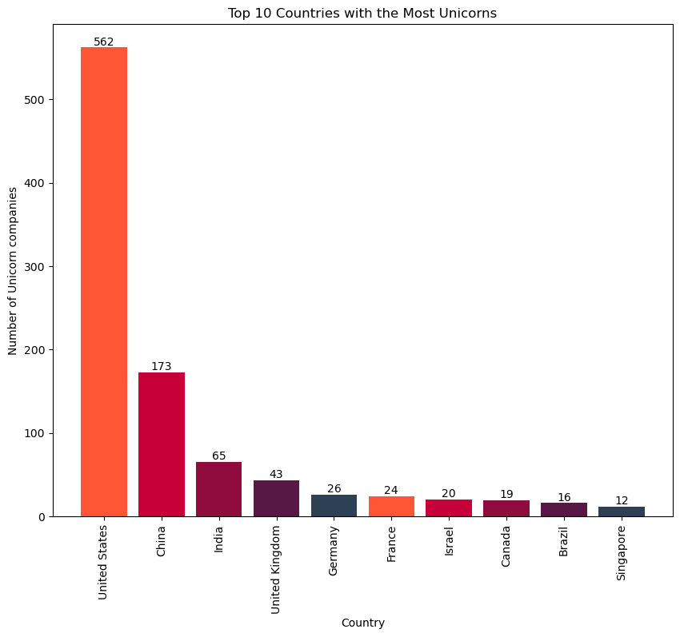
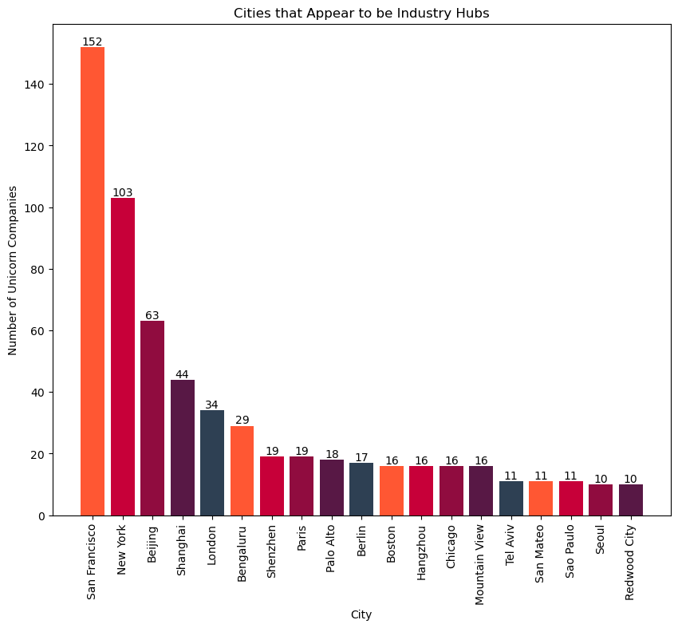
Which countries have the most unicorns? Are there any cities that appear to be industry hubs?
Observation
Using the chart above, United states appears to be the topmost country with the highest number of unicorns with a value of 526, followed by China with a value of 173 and it follows suit until the Singapore, which records the lowest number of unicorns with a value of 12.
Observation
the bar chat above also shows the cities with the most Industrial hubs. logically since United States recorded the highest unicorns, it just makes sense to also have San Francisco and New York record the highest number of industrial hubs with values 152 and 103 respectively. Whereas China follows suit as Beijing and Shanghai also records in third and fourth place with values of 63 and 44 respectively. On the other hand, Redwood City records the lowest Industrial hub with a value of 10. There should be a market survey to find the reason for recording the lowest values and encouragement of investors by the Government to invest in these start up unicorns with proper returns policies and working environment so as to promote the growth of unicorn companies.

Slide 6
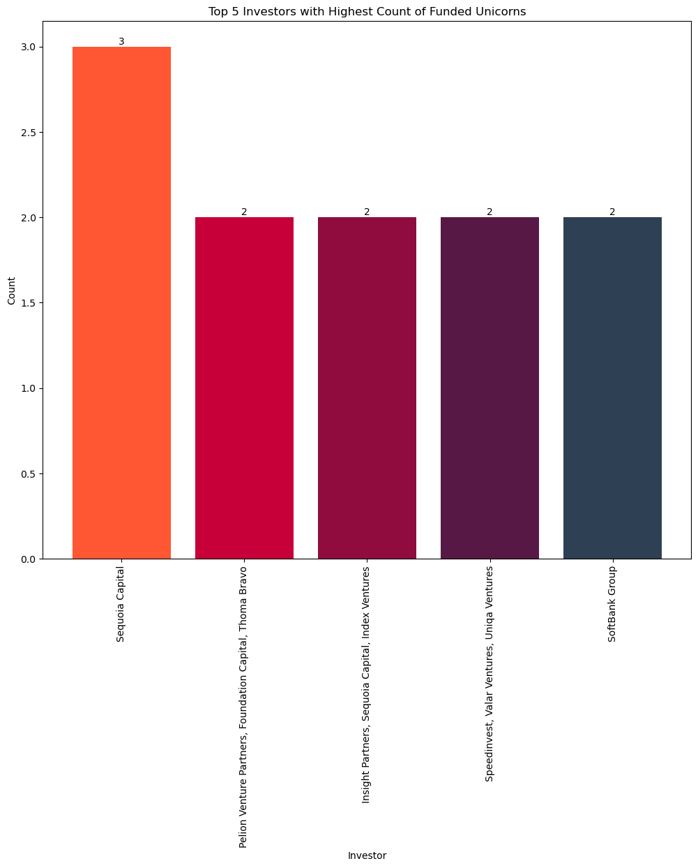
Which Investors have funded the most Unicorns
Observation
Sequoia Capital appears to have funded the most unicorns and that makes them the top investor among others. the remaining 4 investors from the bar chart above have the same number of investments. This is good because there is competition for returns by Investors and so they must be encouraged with improved and irresistible Investment policies to help move the number of investors up.

Slide 7
Findings
&
Recommendations
After thorough Analysis of the Dataset, I noticed that there is a positive distribution of unicorn companies across different industry sectors and it makes it easy to identify which sectors are most successful in producing unicorns and potentially identify emerging sectors with high growth potential.
It is easy to identify the primary sources of funding for unicorn companies. Also we now have the knowledge on which companies receive funding from venture capital firms, private equity, corporate investments, or other sources and their souce of primary funding.
it is easier to know which areas unicorn companies faulter and need attention and which areas have the highest concentration of unicorns, indication favorable grounds for potential investors to pay attention to.
It is now easy to identify common success factors among unicorn companies. This finding can provide insights into the key attributes, strategies, or characteristics that contribute to a company's ability to achieve unicorn status.
it is possible to identify the longevity of unicorn companies. This information can help understand whether unicorns tend to sustain their valuation over time or experience fluctuations in their market value.
On the general, there is a promising growth in Unicorn Companies after the pandemic as more strategic ways have been implemented to promote business.
Foster a strong company culture: Cultivate a positive and inclusive work environment that values collaboration, innovation, and employee well-being. A strong company culture attracts and retains top talent, fosters creativity, and promotes a sense of purpose and dedication among employees.
Prioritize talent acquisition: Identify and recruit skilled and diverse professionals who align with the company's vision and values. Implement effective talent retention strategies such as competitive compensation packages, professional development opportunities, and a supportive work-life balance.
Focus on innovation and adaptability: Encourage a culture of continuous learning and innovation within the organization. Foster an environment where employees are encouraged to think outside the box, experiment, and adapt to changing market trends and customer needs.
Build strong partnerships and networks: Collaborate with strategic partners, investors, and industry experts to leverage their knowledge, resources, and networks. Building strong relationships can lead to valuable insights, access to new markets, and potential business opportunities.
Develop a robust marketing and branding strategy: Invest in building a strong brand identity and effective marketing campaigns to create awareness and attract customers. Utilize digital marketing channels, social media, and content marketing to reach a wider audience and differentiate the company from competitors.
Maintain a customer-centric approach: Continuously gather customer feedback and insights to understand their needs, preferences, and pain points. Use this information to improve products, services, and customer experiences, ensuring that the company remains customer-focused.
Embrace technology and digital transformation: Stay updated with technological advancements and leverage them to streamline operations, enhance productivity, and improve customer experiences. Embracing digital transformation can lead to increased efficiency, scalability, and competitive advantage.
Develop a sustainable growth strategy: Focus on long-term growth and sustainability rather than short-term gains. Balance expansion with financial stability, ensuring that the company's growth is supported by strong financial management and a sustainable business model.
Engage in corporate social responsibility: Demonstrate a commitment to social and environmental causes by engaging in corporate social responsibility initiatives. This can enhance the company's reputation, attract socially conscious customers and investors, and contribute to positive societal impact.
Foster a culture of learning and adaptability: Encourage a growth mindset and a willingness to learn from failures and setbacks. Embrace a culture of continuous improvement and adaptability to navigate challenges and seize new opportunities.

Slide 8




Thank You
Michael Biney
michael.biney@rocketmail.com
Quantum Analytics, June Cohort

